Slide 1
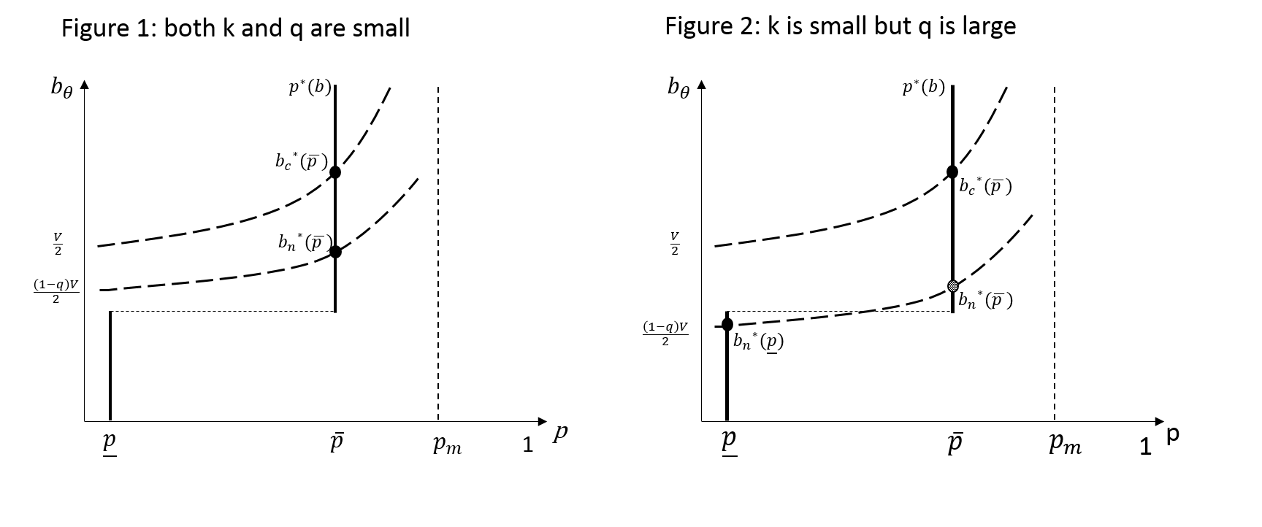
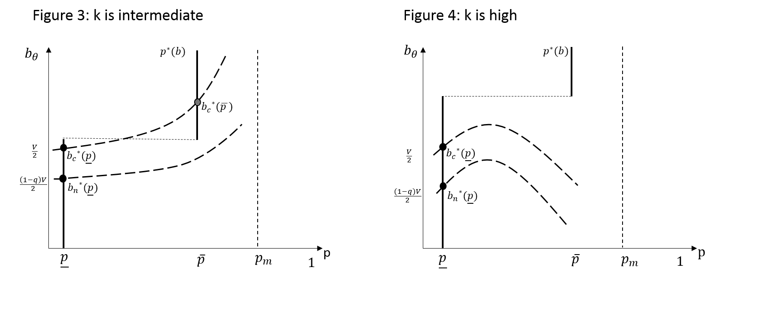
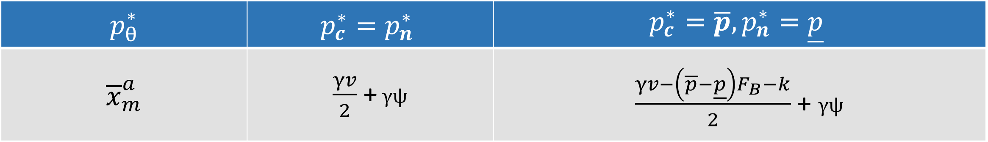
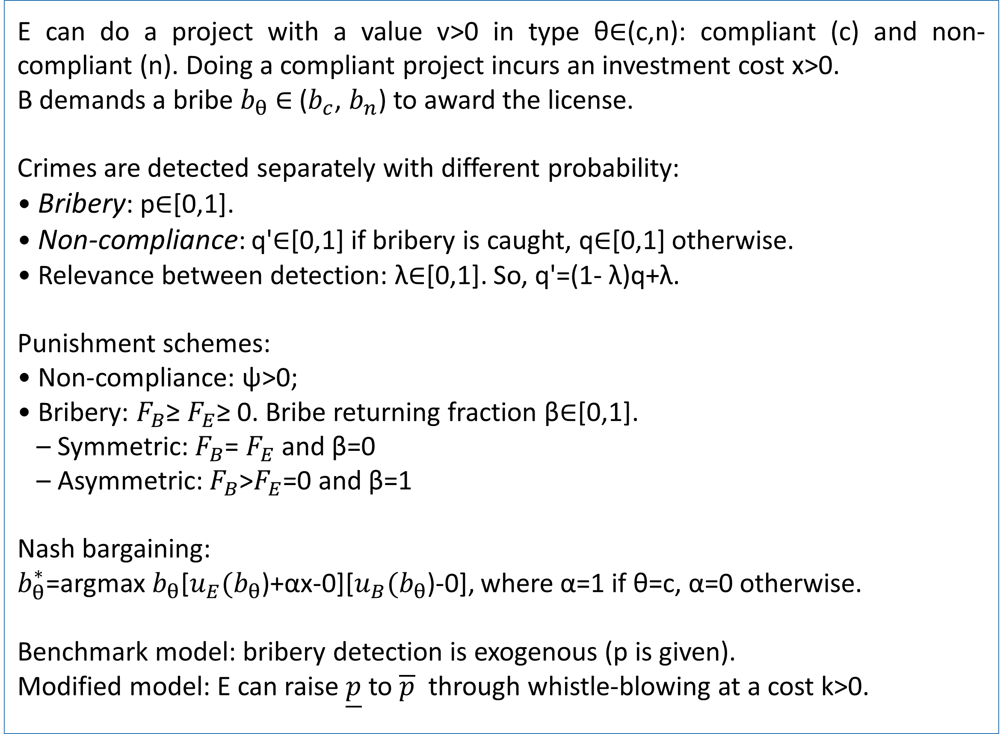
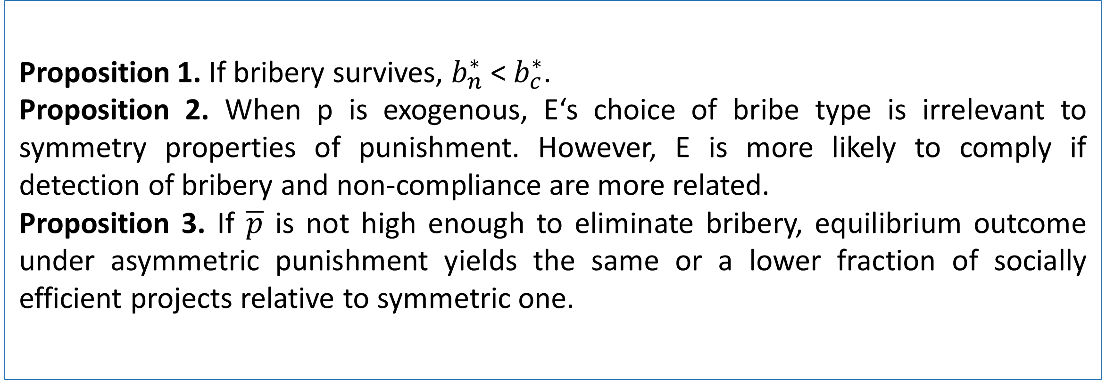
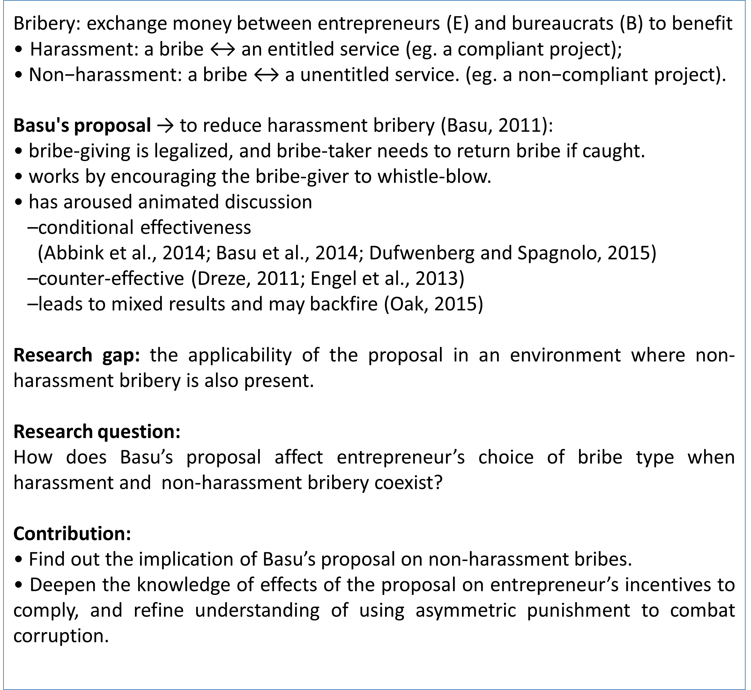
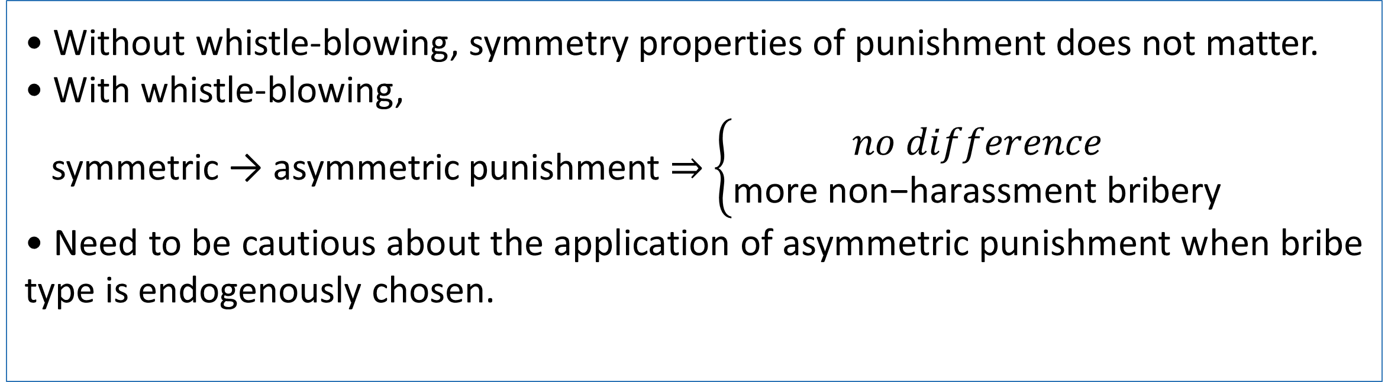
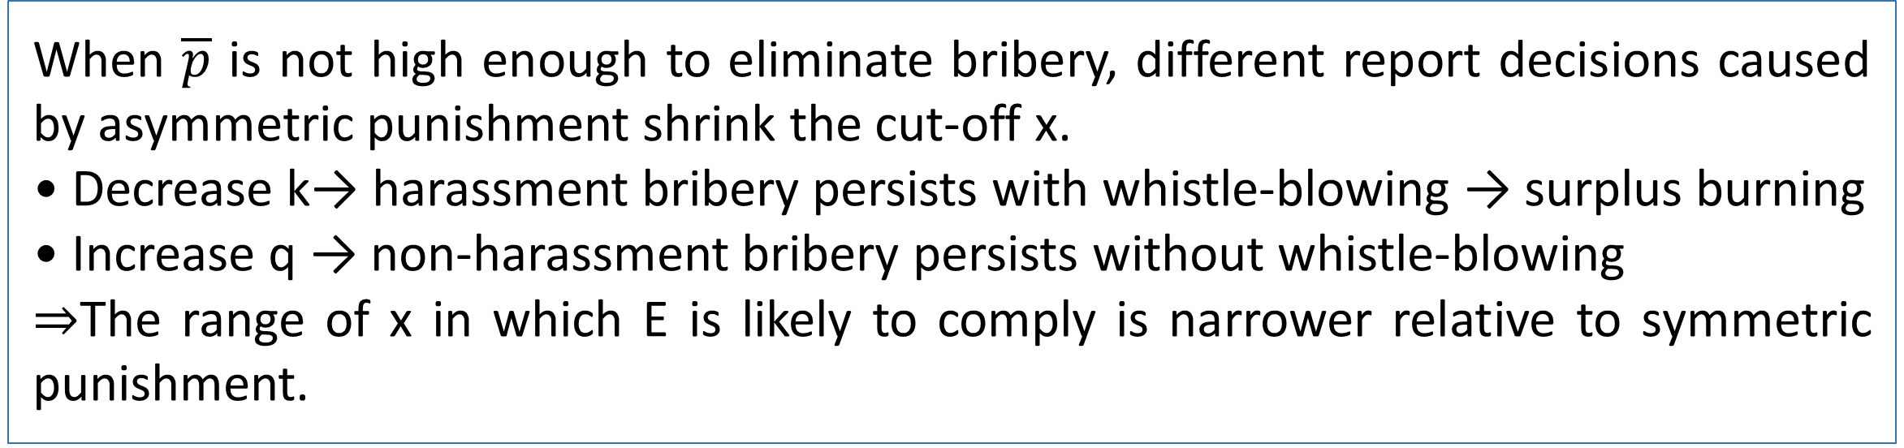
The Endogenous Choice of Bribe Type under Asymmetric Punishment
Lin Hu, PhD
School of Economics, the University of Adelaide
Abstract
Results
The control of bribery is a policy objective in many developing countries. It has been argued that asymmetric punishment can eliminate harassment bribery if both whistle-blowing if cheap and effective. In a more realistic environment where bribery is most likely to survive and another type of bribery—non harassment one—coexists, this paper investigates how asymmetric punishment affects the endogenous choice of bribe type to the bribe-giver. When whistle-blowing is feasible, a switch from symmetric to asymmetric punishment leads to either no difference or more non-harassment bribery. The result is robust when the legalization of bribe-giving is not feasible to non-harassment bribes.
Proposition 1. If bribery survives, $b_{n}^{∗}$ < $b_{c}^{∗}$.
Proposition 2. When p is exogenous, E‘s choice of bribe type is irrelevant to symmetry properties of punishment. However, E is more likely to comply if detection of bribery and non-compliance are more related.
Proposition 3. If $\overline{p}$ is not high enough to eliminate bribery, equilibrium outcome under asymmetric punishment yields the same or a lower fraction of socially efficient projects relative to symmetric one.
Introduction
Equilibrium under Asymmetric Punishment
Bribery: exchange money between entrepreneurs (E) and bureaucrats (B) to benefit
• $\text{Harassment}\text{: }\text{a} \text{bribe}\text{ ↔ }\text{an} \text{entitled} \text{service}\text{ (}\text{eg}\text{. }\text{a} \text{compliant} \text{project}\text{); }$
• $\text{Non}\text{−}\text{harassment}\text{: }\text{a} \text{bribe}\text{ ↔ }\text{a} \text{unentitled} \text{service}\text{. (}\text{eg}\text{. }\text{a} \text{non}\text{−}\text{compliant} \text{project}\text{)}\text{.}$
Basu's proposal → to reduce harassment bribery (Basu, 2011):
• bribe-giving is legalized, and bribe-taker needs to return bribe if caught.
• works by encouraging the bribe-giver to whistle-blow.
• has aroused animated discussion
–conditional effectiveness
(Abbink et al., 2014; Basu et al., 2014; Dufwenberg and Spagnolo, 2015)
–counter-effective (Dreze, 2011; Engel et al., 2013)
–leads to mixed results and may backfire (Oak, 2015)
Research gap: the applicability of the proposal in an environment where non-harassment bribery is also present.
Research question:
How does Basu’s proposal affect entrepreneur’s choice of bribe type when harassment and non-harassment bribery coexist?
Contribution:
• Find out the implication of Basu’s proposal on non-harassment bribes.
• Deepen the knowledge of effects of the proposal on entrepreneur’s incentives to comply, and refine understanding of using asymmetric punishment to combat corruption.
Table 1. The cut-off investment cost under asymmetric punishment.
Model
$$p_{θ}^{∗}$$ | $$p_{c}^{∗}=p_{n}^{∗}$$ | $$p_{c}^{∗}=\overline{p}, p_{n}^{∗}=\underline{p}$$
$${\overline{x}}_{m}^{a}$$ | $\frac{γv}{2}$ +$γψ$ | $\frac{γv−\left(\overline{p}−\underline{p}\right)F_{B}−k}{2}$ + $γψ$
E can do a project with a value v>0 in type θ∈(c,n): compliant (c) and non-compliant (n). Doing a compliant project incurs an investment cost x>0.
B demands a bribe $b_{θ}$ ∈ ($b_{c}$, $b_{n}$) to award the license.
Crimes are detected separately with different probability:
• Bribery: p∈[0,1].
• Non-compliance: q'∈[0,1] if bribery is caught, q∈[0,1] otherwise.
• Relevance between detection: λ∈[0,1]. So, q'=(1- λ)q+λ.
Punishment schemes:
• Non-compliance: ψ>0;
• Bribery: $F_{B}$≥ $F_{E}$≥ 0. Bribe returning fraction β∈[0,1].
– Symmetric: $F_{B}$= $F_{E}$ and β=0
– Asymmetric: $F_{B}$>$F_{E}$=0 and β=1
Nash bargaining:
$b_{θ}^{∗}$=argmax $b_{θ}$[$u_{E}(b_{θ}$)+αx-0][$u_{B}(b_{θ}$)-0], where α=1 if θ=c, α=0 otherwise.
Benchmark model: bribery detection is exogenous (p is given).
Modified model: E can raise $\underline{p}$ to $\overline{p}$ through whistle-blowing at a cost k>0.
Discussion
When $\overline{p}$ is not high enough to eliminate bribery, different report decisions caused by asymmetric punishment shrink the cut-off x.
• Decrease k→ harassment bribery persists with whistle-blowing → surplus burning
• Increase q → non-harassment bribery persists without whistle-blowing
⇒The range of x in which E is likely to comply is narrower relative to symmetric punishment.
Conclusions
• Without whistle-blowing, symmetry properties of punishment does not matter.
• With whistle-blowing,
symmetric → asymmetric punishment ⇒ $\left\{\begin{aligned}no difference \\ \text{more} \text{non}\text{−}\text{harassment} \text{bribery}\end{aligned}\right.$
• Need to be cautious about the application of asymmetric punishment when bribe type is endogenously chosen.
Contact
References
Lin Hu
The University of Adelaide
Email: lin.hu@adelaide.edu.au
Abbink, K., Dasgupta, U., Gangadharan, L., Jain, T., 2014. Letting the briber go free: an experiment on mitigating harassment bribes. Journal of Public Economics 111, 1728.
Basu, K., 2011. Why, for a Class of Bribes, the Act of Giving a Bribe should be Treated as Legal. DEA, Ministry of Finance, Government of India.
Basu, K.; Basu, K. & Cordella, T., 2014. Asymmetric punishment as an instrument of corruption control. World Bank Policy Research Working Paper.
Dreze, J., 2011. The bribing game. Indian Express April 23.
Dufwenberg, M. & Spagnolo, G., 2015. Legalizing bribe giving. Economic Inquiry 53(2), 836-853.
Engel, C.; Goerg, S. J. & Yu, G., 2013. Symmetric vs. asymmetric punishment regimes for bribery. Max Planck Institute for Research on Collective Goods, Working Paper.
Oak, M., 2015. Legalization of bribe giving when bribe type is endogenous. Journal of Public Economic Theory 17, 580-604.

