Slide 1
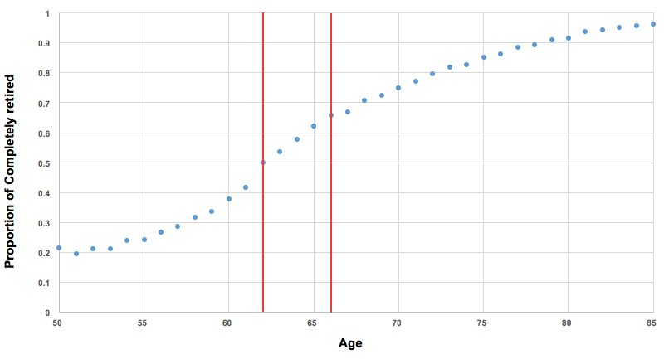
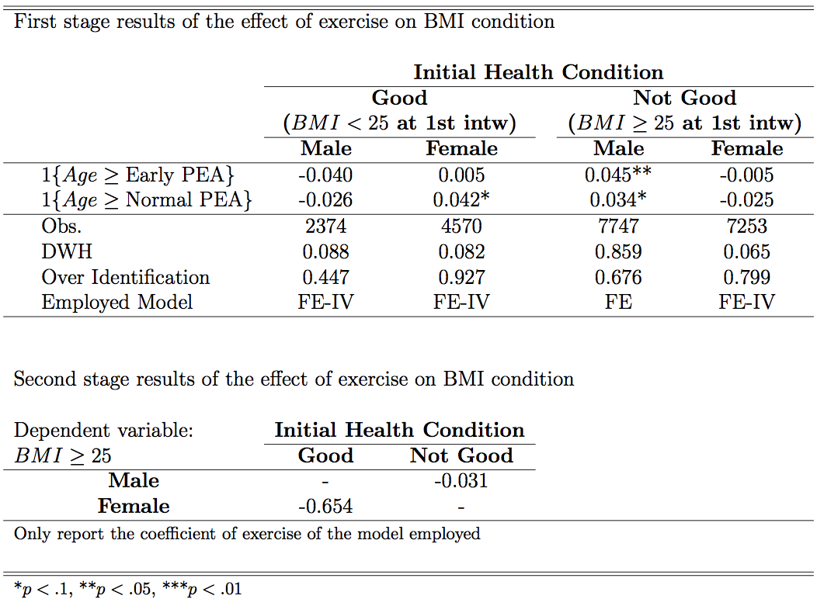
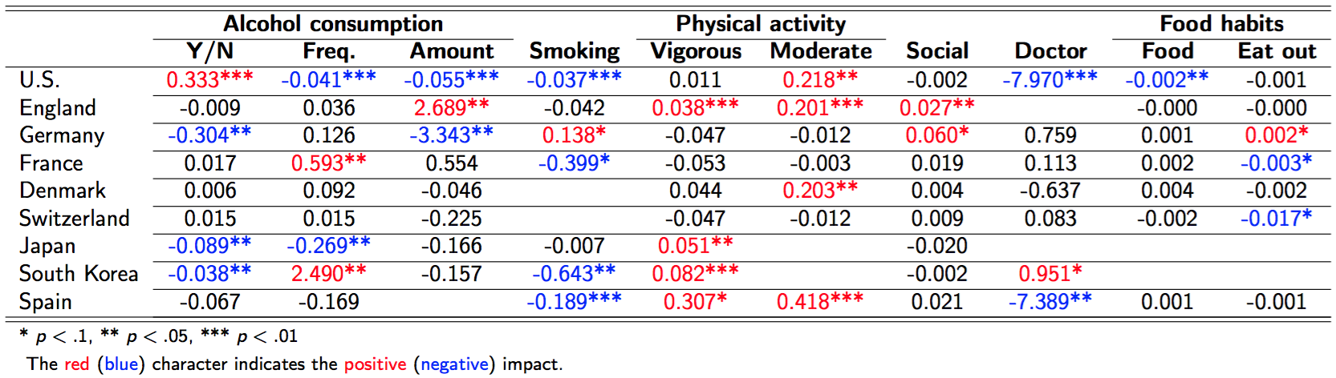
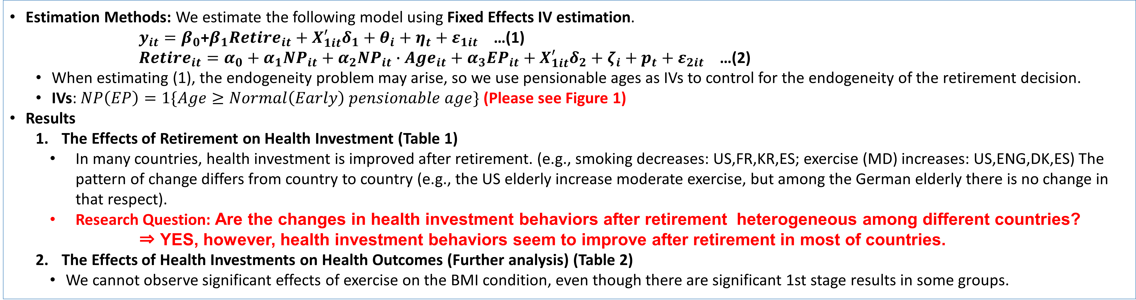
Examining the Changes in Health Investment Behavior After Retirement
(Formerly titled: An International Comparative Study of Health Investment Behaviors After Retirement)
Hiroyuki Motegi¹; Yoshinori Nishimura¹; Masato Oikawa¹
¹ Graduate School of Economics, University of Tokyo
Abstract
This study examines the effects of retirement on health investment behaviors.
We conduct a large-scale international comparison of the change in health investment behaviors after retirement among 9 developed countries, using harmonized datasets and estimation methods.
We find that health investment behaviors are improved after retirement in most of countries.
Introduction
Data and Variables
The Effect of Retirement on Health
  Since Kerkhofs and Lindeboom (1997), a number of studies have investigated the relationship between retirement and health over the last two decades.
  There are, however, no unified views on the impact of retirement on various health indexes.
  Why do these studies report different estimated results regarding the link between retirement and health?
  Among different countries, different estimated results are observed in some of the health indexes.
The Mechanism of the Retirement Effect on Health: Health Investment Change
  Health capital is determined by health investment. (Grossman (1972))
  The difference in the estimated results can be explained by heterogeneity in the changes in health investment behaviors after retirement among different countries.
The Effect of Retirement on Health Investment Behavior
  Eibich (2015) is the first study to clearly point out and investigate the mechanism by using German data. HOWEVER, Eibich (2015) solely focused on the case of Germany, and thus, his findings CANNOT be generalized.
  Research Question: Are the changes in health investment behaviors after retirement heterogeneous among different countries?
Data
  We use internationally comparable panel studies of elderly people.
  HRS (the US), ELSA (England), SHARE (European countries), JSTAR (Japan), KLoSA (South Korea)
Definition of Health Investment Behavior
  We define the following behaviors as health investment behaviors:
  Alcohol consumption (Y/N, freq., amount), smoking (Y/N), physical activity (Freq.), social attendance, visits to doctor, food habits (expenditure).
Definition of Retirement
  We consider that an elderly person is retired if he or she meets the following TWO conditions:
    Did not do paid work in the survey year;
    Reported his/her employment status as not employed/not active in the labor market (e.g., retired, disabled, or homemaker).
Contact & References
Yoshinori Nishimura, Graduate School of Economics, University of Tokyo
Email: nishimura.yy@gmail.com
Eibich, P.(2015). Understanding the Effect of Retirement on Health: Mechanisms and Heterogeneity. Journal of Health Economics, 43:1-12
Grossman, M. (1972). On the Concept of Health Capital and the Demand for Health. Journal of Political Economy, 80(2)223-255.
Kerkhofs, M. and Lindeboom, M. (1997). Age related health dynamics and changes in labour market status. Health Economics, 6(4):407-423.
Methods and Results
Estimation Methods: We estimate the following model using Fixed Effects IV estimation.
$y_{it}=β_{0}$+$β_{1}{Retire}_{it}+X_{1it}^{′}δ_{1}+θ_{i}+η_{t}+ε_{1it}$ …(1)
${Retire}_{it}=α_{0}+α_{1}{NP}_{it}+α_{2}{{NP}_{it}∙Age}_{it}+α_{3}{EP}_{it}+X_{1it}^{′}δ_{2}+ζ_{i}+p_{t}+ε_{2it}$ …(2)
  When estimating (1), the endogeneity problem may arise, so we use pensionable ages as IVs to control for the endogeneity of the retirement decision.
  IVs: $NP\left(EP\right)=1\{Age≥Normal\left(Early\right) pensionable age\}$ (Please see Figure 1)
Results
  The Effects of Retirement on Health Investment (Table 1)
    In many countries, health investment is improved after retirement. (e.g., smoking decreases: US,FR,KR,ES; exercise (MD) increases: US,ENG,DK,ES) The pattern of change differs from country to country (e.g., the US elderly increase moderate exercise, but among the German elderly there is no change in that respect).
    Research Question: Are the changes in health investment behaviors after retirement heterogeneous among different countries?
    ⇒ YES, however, health investment behaviors seem to improve after retirement in most of countries.
  The Effects of Health Investments on Health Outcomes (Further analysis) (Table 2)
    We cannot observe significant effects of exercise on the BMI condition, even though there are significant 1st stage results in some groups.
Figure 1. The Relationship between Retirement and Pension Eligibility Age in the US (1st stage)
Table 2. The Effect of Exercise on BMI condition in the US Elderly Aged 50-74 (BMI≧25)
Table 1. The Effects of Retirement on Health Investment Behaviors (9 developed countries)

