Slide 1



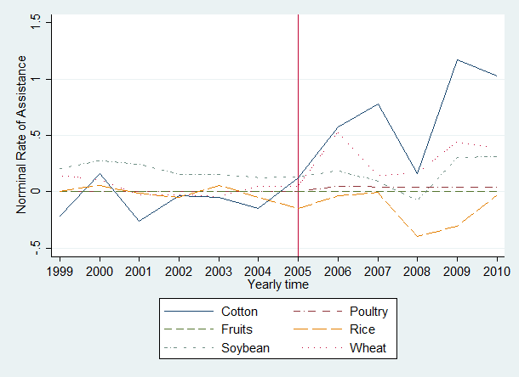
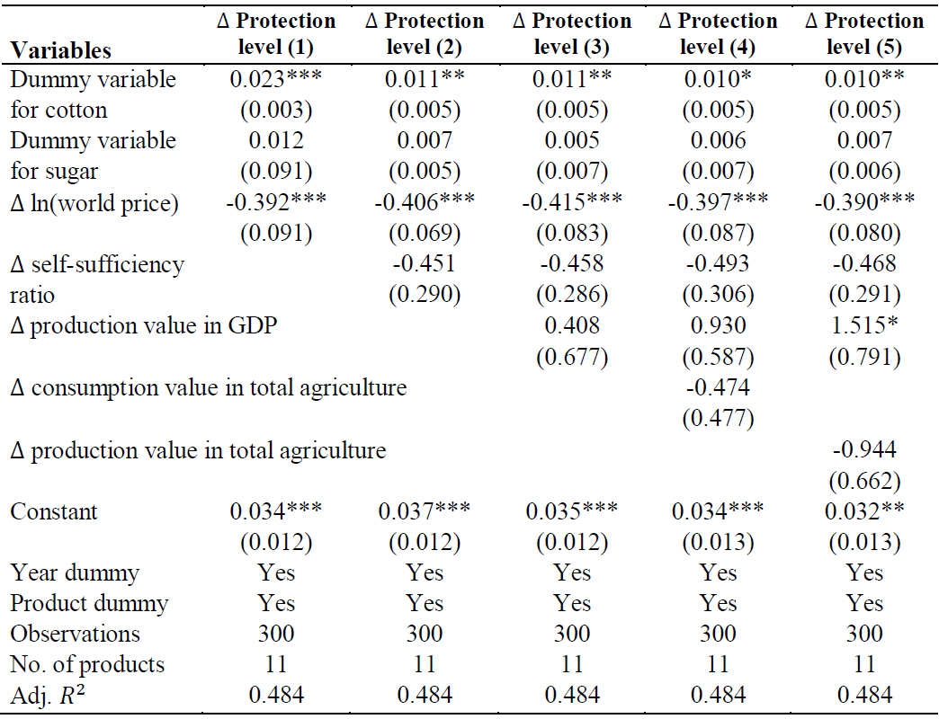
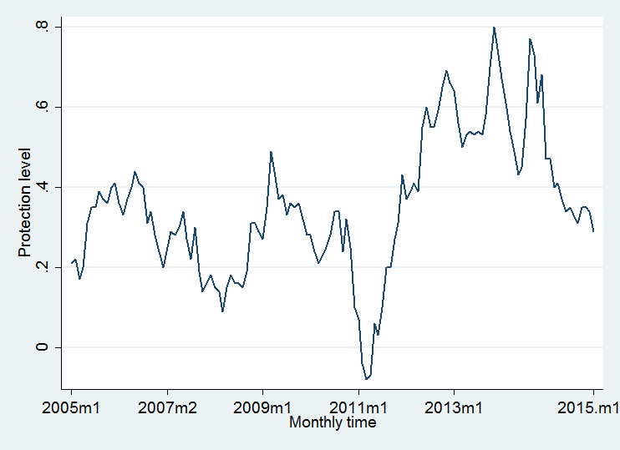
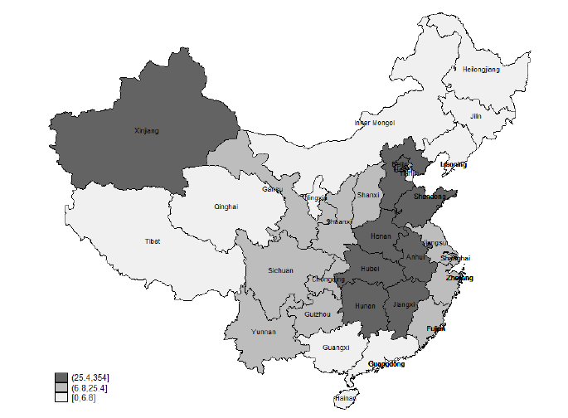
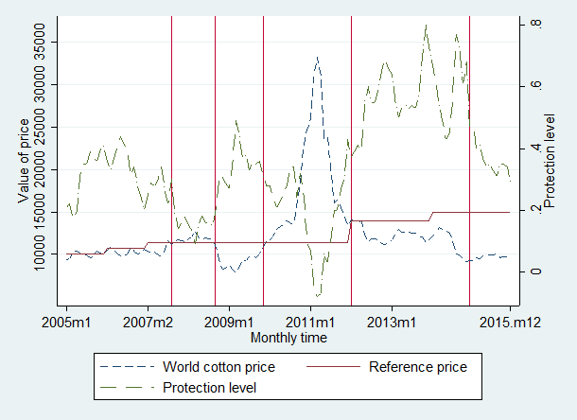
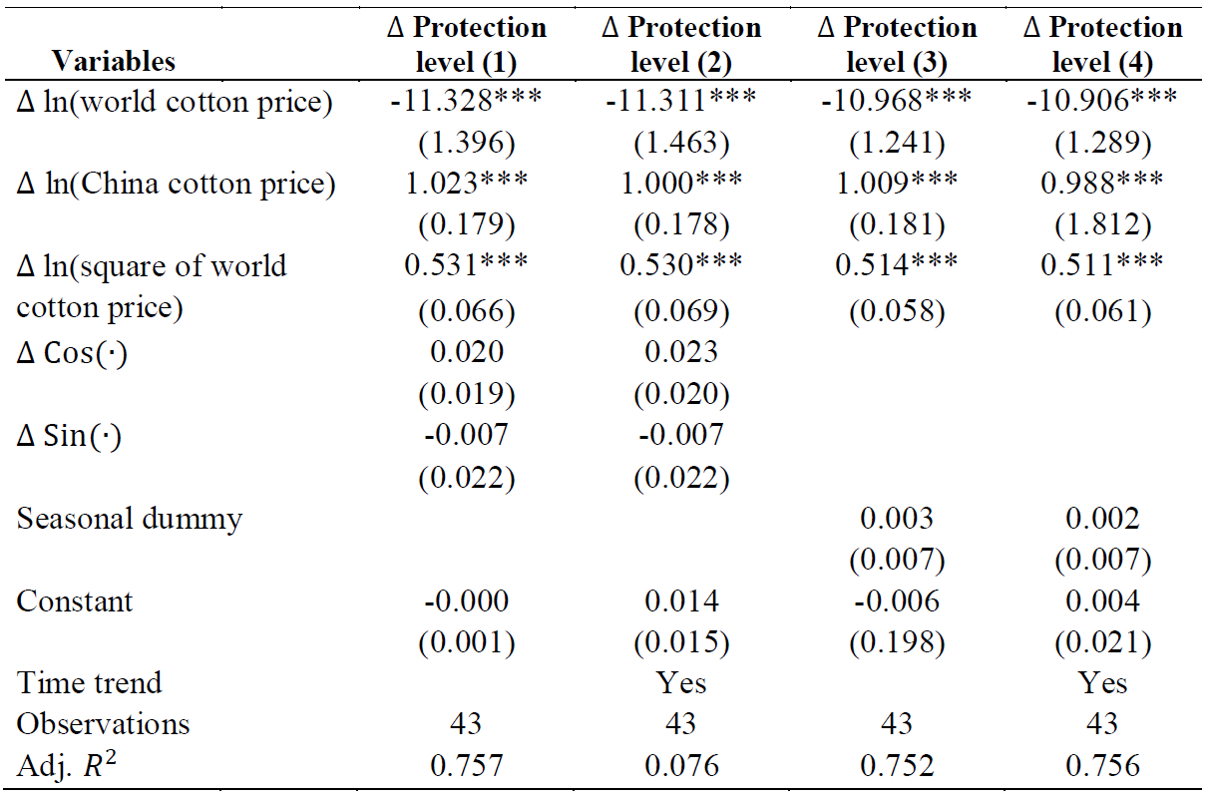

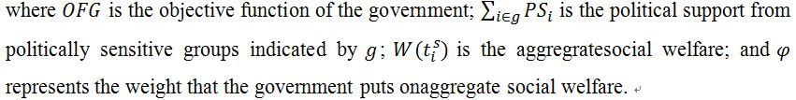

Geographic politics, loss aversion, and trade policy: The case of cotton and China
Wenshou Yan PhD¹
School of Economics, The University of Adelaide
Abstract
Theoretical Model Predictions
This paper seeks to explain how governments response to world market price fluctuations. It develops a theoretical model of trade policy incorporating loss aversion and reference dependence. Like Freund and Özden (2008), this paper assumes only trade policy instruments are available to the government, but it goes beyond their model by adding a spatial dimension to interest-group politics. The model suggests that: (1) politically sensitive products receive more trade protection; (2) the government’s changing trade distortions insulate the domestic market from international price fluctuations by setting trade protection lower (higher) when the world price is higher (lower) than a targeted domestic reference price; and (3) variations in market intervention help producers at the expense of consumers in periods when the international price is well below trend, and help consumers at the expense of producers in high-price periods. These predictions from theory are shown to still hold when the model is extended to a large country case involving terms of trade effects. The model is tested empirically and found to offer a plausible explanation of the puzzling changes in cotton protection in China.
Benchmark results: Politically sensitive groups receive positive protection. The protection level is positively related to the output-import ratio; negatively proportional to the share of the total population in the politically sensitive regions, the import demand elasticity, and the government’s weight on the aggregate social welfare.
Proposition 1: When the world price is below its reference price, the government introduces a higher distortion than the level of distortion when the world price is at the reference level.
Proposition 2: When the world price goes higher than the reference price, the government introduces lower distortions than the level of distortion introduced when the world price is at its reference price.
Introduction and Motivation
During the fluctuation periods, governments are trying to apply trade distortions to insulate domestic market from the world market price. In the short run, China’s cotton trade protection varies during 2005-2015 (Figure 1) , and The proportion of cotton production in Xinjiang increases from 32% (2005) to 62% (2015) .
Research question: How does the government response to the fluctuations of the international market price?
Figure 1 Cotton trade protection Figure 2 Cotton production in China
Empirical Test I: Political Sensitive Effect
Political sensitive products receive higher protection
Figure 3 Trade protections Table 1 Political sensitive effects
Empirical Test II: Loss Aversion Effect
Figure 4 Loss aversion effects Table 2 Loss aversion effects
What this Paper Does?
• Set a theoretical model through combining political support model (Hillman, 1982) and government preference function (Baldwin. 1987)
• The government’s trade policy formation process in a one-party country characterised with geographic dimensions of interest-group politics, rather than in a democracy country like Grossman and Helpman (1994), and based on general equilibrium scenario.
• It considers two cases (when the world price is higher, as well as when it is lower, than a reference price), which therefore goes beyond Freund and Özden (2008) who only consider a world price slump.
• Take cotton and China as a case study
Conclusion
The Model
• Theoretical predictions:
– Politically sensitive products receive more trade protection;
– Loss aversion effect: Variations in market intervention help producers at the expense of consumers in periods when the international price is well below trend, and help consumers at the expense of producers in high-price periods;
– Loss aversion effect is independent of politically sensitive effect;
– These predictions are shown to still hold when the model is extended to a large country case involving terms of trade effects;
• The model is empirically found to offer a plausible explanation of the puzzling changes in cotton protection in China.
• The government set the objective function as the summation of the political support from political sensitive groups and the total social welfare of the economy.
If we assume that the political support function is a monotonic increasing function with respect to their welfare, the government objective function is rewritten as:
Contact
References
1. Baldwin, R.E. (1987). Political realistic objective functions and trade policy PROFs and tarif. Economic Letters, 24, 287-290.
2. Freund, C., & Özden, Ç. (2008). Trade policy and loss aversion. American Economic Review, 98(4), 1675-1691.
3. Hillman, A. L. (1982). Declining industries and political-support protectionist motives. The American Economic Review, 72(5), 1180-1187.
4. Grossman, G. M., & Helpman, E. (1994). Protection for sale. The American Economic Review, 84(4), 833-850.
Wenshou Yan
School of Economics, The university of Adelaide
Email: wenshou.yan@adelaide.edu.au
Website: http://wenshouyan.weebly.com/

