Slide 1
Are the Children of Uneducated Farmers Doubly Disadvantaged? Farm, Nonfarm and Intergenerational Educational Mobility in Rural China
M. Shahe Emran IPD, Columbia University
Yan Sun The World Bank

Slide 2
The Big Picture: Economic Liberalization, Poverty and Inequality
Liberalization Led to Poverty Reduction, but With Increasing Inequality
Education: The Most Important Policy Instrument (The Economist, Joe Stiglitz, Raghu Rajan…)
Effects of Socio-economic Background (Permanent Income) on Schooling
Life With Limited Income Data
Current Literature: Parent’s Education as a Sufficient Statistic
Disconnect Between Economics and Sociology: Parent’s Occupation
Potential Interactions Between Education and Nonfarm Occupation, Possibility of Bifuracation
Notes:
Increasing inequality despite economic growth and poverty reduction; become a central policy issue in both developed countries and developing countries
Education is one of the most important policy instruments to make moderate the inequality generated by market reform. We try to understand potential disadvantages faced by children from a poor socio-economic background in attaining the education.
The economic literature on intergenerational educational mobility has focused on parental education as the relevant indicator of family background; this approach is not satisfactory if the focus is on the role of family background in generating educational inequality; this approach ignores the role of parents’ occupation, which is one important indicator of social mobiity; in developing countries, non-farm occupation yield higher income,
Positive feedbacks among education, nonfarm occupation and income may lead to a bifuration , where the children born into parents with hgiher education and nonfarm education enjoy a clear and cumulative advantage in education, while the children of uneducated farmers are trapped in a low educational attainment.

Slide 3
The Context: Rural China
Growth in Non-farm Employment: Structural Change
Educated farmers Took Advantage of the Growing Non-farm Opportunities (Yang, 2004)
Rising inequality
The role of non-farm income (Benjamin et al., 2005)
Similar Evidence in India
Rural-Urban Migration and Schooling of Poor Children (de Baruw et al., 2012)
Increasing Returns to Education (de Brauw and Rozell, 2008)
Fiscal decentralization and education inequality (Hannum et al. (2008)
Notes:
non-farm income played an important role in worsening income distribution in rural china since 1995.
Returns to education have been increasing over the reform era

Slide 4
Research Questions
Broader Measure of Permanent Income and Heterogeneity in the Effects of Family Background
A Dollar More than a Dollar? Income Effect for Different Sources of Income
Parental Education and Occupation: Complementary, Substitutes, or Separable? In Search for Positive Feedback Mechanism
Economic Reform and Educational Mobility: Three Generations Compared
Notes:
The focus of this paper is on the role of family background as measured by parental education and occupation in the evolution of educational inequality among children in rural China, across generations.
A comparison of the children in non-farm but low education households, with the children in farm but high education households helps us to understand better the relative roles of family resources (income effect) and a human capital effect not mediated through income. Non-farm households in general have higher income, we want to test the hypothesis that children’s educational inequality is primarily a poverty problem in rural economy
Whether parental education and occupation are mutually complementary or substitutes in the production of educational attainment of children?

Slide 5
The Empirical Framework (1)
Single Factor Model of Educational Mobility
Single Factor Model of Occupational Mobility
Educational Mobility in a Two factor Model
Notes:
This is the standard regression specification for analyzing the persistence in education attainment across generation, the assumption is that the effect of parental education is constant for all households, so a1 captures the average of the effect;
The regression specification for intergenerational occupational mobility,
The economic literature on intergenerational mobility has focused on education and occupation linkages separately, largely ignoring any possible cross effects.
Both parental education and occupation are potentially important for children’s education attainment, what is interaction between them: complementary or substitutes?

Slide 6
The Empirical Framework (2)
Binary Indicators of Parents’ Status
Non-parametric model:
Is the omitted group
Complementarity?
Education mediated through income?
Complementarity?
Notes:
Limitation: assumption in linearity in parameters, we split the sample in four mutually exclusive groups in terms of binary indicators of parents’ educational and occupational status;
Complementarity: the intersection has a stronger effect than the union?
Non-farm households enjoy higher income, even when the farm households are better endowed in terms of human capital. Under the null hypothesis that low schooling attainment is due to parents’ low income alone, parental education would matter only as it affects income; or in contrast, the effects of having higher educated farmer parents is higher, this would imply that parental education has important effects not mediated through income.

Slide 7
Econometric Approaches
Most of the Existing Studies Rely on OLS
Estimators with CIA
Nearest Neighborhood Matching (Abadie and Imbens (2002))
Bias Corrected Radius Matching (Lechner et al. (2011))
NIPW
Testing for Interaction Effect without Functional Form
Notes:
OLS impose strong functional form assumption and ignores the problem of limited overlap between treatment and comparison groups,
Take a first step to causal interpretation of the estimates
We use two matching estimators and two estimators based on propensity score weighting
Nearest neighborhood matching. Nonparametric (no explicit functional form for either the outcome model or the treatment model is specified). For each individual, matching estimators use the most similar individual(s) that get the other treatment level to impute the missing potential outcome. Do this for each person. The difference between the observed outcome and the imputed potential outcome is essentially an estimate of the expected individual-level treatment effect conditional on the covariates.
Radius matching. Perform very well under among a wide set of estimators.
Normalized inverse propensity score weighted estimator. IPW estimators weight observations on the outcome variable by the inverse of the probability that it is observed. Observations that are not likely to contain missing data get a weight close to one, observations that are likely to contain missing data get a weight larger than one. NIPW reduces biases compared to the OLS estimates by using appropriate weighting.
Minimum biased estimator. It minimizes the biases arising from selection on unobservables. It yields more reliable estimates of the causal effects when the conditional independence assumption fails. The MB-NIPW estimator performs particularly well when the estimating equation suffers from omitted variables. But it provides estimates for a sub population.

Slide 8
Approaches to Causal Effects
Genetic Correlation or Causal Effect?
Positive Genetic Transmissions: Plomin et al: Correlation in IQ About 0.50
Implement Three Approaches
Rosenbaum Bounds
Minimum Biased IPW Estimator (Millimet and Tchernis (2013)
Lewbel Heteroskedasticity Based Instrumental Variables Approach
Only Study to Provide Causal Estimates (Earlier Causal Estimates for Single Factor Model by Emran and Sun (2011))

Slide 9
Data
Parents-grandparents sample (14,777 pairs)
Does not suffer from coresidency bias
Chinese Household Income Project (CHIP), 2002 round
Rural sample
Covers three generations: grandparents-parents-children
Includes non-resident children
<= 6 months; > 6 months, but with significant economic tie with the household
Rural-urban migrant household survey
In the urban areas with rural Hukou;
Missing long-term migrants from the rural survey
>=1 year
Still have family member in the rural
Weak economic tie with their original home in the rural (remittance rate<20%)
The parents-children sample
5909 adult children-parents pairs from rural survey
1355 adult children-parents pairs from migrant survey
Notes:
We use survey data from rural china that cover three generations and are not subject to coresidency bias
The rural survey includes a significant proportion of the non-resident children, all of the non-resident children who had not been away for more than six months were included as household members; among those who had been away for more than 6 months, the survey counted a child as port of the household, if she/he had significant economic connection
This is the module for the complete parental information of the household heads and spouses, including parents coresiding , not co-residing, and who had passes away.

Slide 10
Samples Across Parents’ Economics Status
 | Parents' Low Education | Parents' high education
Farmer Parents
 | 2494 | 2403
 | (children-parents sample) | (children-parents sample)
 | 11,571 | 2204
 | (parents-grandparents sample) | (parents-grandparents sample)
Parents in off-farm
 | 621 | 1746
 | (children-parents sample) | (children-parents sample)
 | 690 | 312
 | (parents-grandparents sample) | (parents-grandparents sample)
Notes:
We develop a research design in terms of two binary indicators of parents’ economic status: high education, and non-farm occupation, and split the sample into four mutually exlclusive groups.

Slide 11
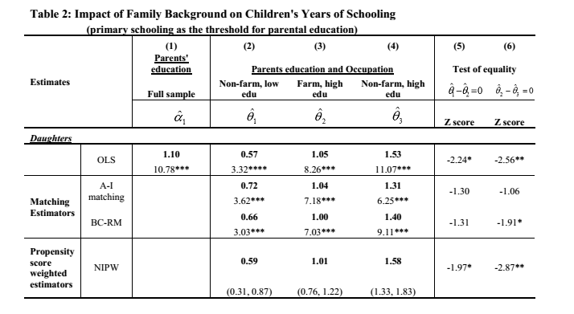

Slide 12
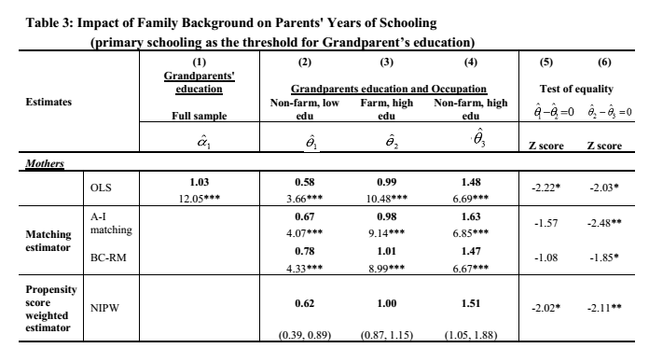

Slide 15
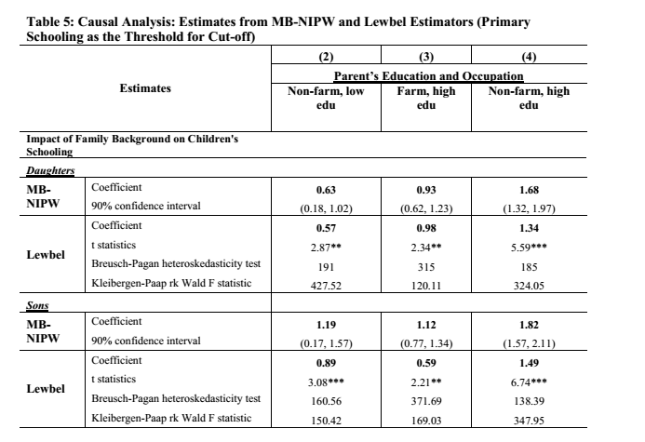

Slide 16
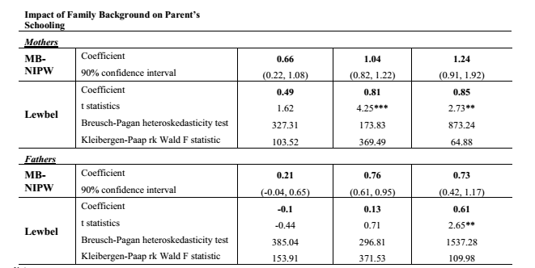

Slide 17
Are Children of the Reform Better Off?
Pre- and Post-Reform Generations
Sons – Family Background More Important after Reform
Girls – Similar Across Generations
Possible Explanations
Increasing Returns to Education, Especially for Boys
Reinforcing Factors: Son Preference, Old-age support
Girls’ Continuation in Schools Depend on Academic Performance (ability)
Notes:
Most of the parents completed their schooling before reform, and most of the children completed their schooling during the reform. A comparison between the grandparents-parents and parents-children samples can provide evidence on the effects of market-oriented reform on children’s education opportunities in rural China;
For girls, the estimated effects of family background remained similar across the two generations; it seems the changes in economic and educational policies seems to have made little difference to the roles played by family background in girls’ education;
The estimates for sons show an increase in the importance of family background over generation

Slide 18
Choosing the Right Parents
Heterogeneity in the Effects of Family Background: What Does the Mean Effect Miss?
Best of Both Worlds: Educated and Rich (Non-farmer) Parents
Rich (Non-farmer), but Uneducated Parents?
Or Educated, but Poor Parents?
A Dollar More than a Dollar’s Worth?
Notes:
If the low schooling attainment of children from unfavorable socioeconomic background is primary a poverty problem, then income transfer or free schooling would be sufficient to address schooling inequality, however, our findings suggest that it is necessary, but not sufficient;
For primary school cut-off, our results how that children born into relatively high income households (low edu, non farm) parents do not enjoy any advantages compared to the poorer households (better edu farmer parents) having poor but more educated parents may confer significant advantages compared to the children from richer but less educated households
The advantages of having more educated poor parents becomes stronger as the level of parental education increases
Policies that reduce income inequality without addressing educational inequality thus may only have limited value in tacking educational inequality in the next generation

Slide 19
Household Per Capita Income
Notes:
Households with non-farm occupation have higher income
Interestingly, the low educated nonfarmers are significantly richer than the more educated farmers,

Slide 20
Household Education Expenditure
Notes:
Parents in general invest substantially more on a sons education
Better educated farmer parents spend more on education of their children when compared to the low educated nonfarmer paretns

Slide 21
Interaction Between Parents Education and Non-farm Occupation (1)
Notes:
Complementarity: Education helps in finding better non-farm jobs, given higher income, the ability to finance education may also be higher;
It also possible that resources are substitute: higher income may enable the parents to buy required educational inputs (tutor). A highly educated parents may not have time to spend with his kids, given hgiher price of labor in the market.
We first test the linear model in equation (3), there is no complementarity
Marginal effect of better education in two subsamples: parents in farming and in nonfarming, it shows there is no evidence ofcomplementarity between parental education and occupation

Slide 22
Interaction Between Parents Education and Non-farm Occupation (2)

Slide 23
Conclusions
Substantial Heterogeneity
Gender Difference
For girls, family background remains stable across generations;
For boys, family background becomes more important
Gender convergence in the effects of family background
Income Plays a Weaker Role Compared to Parental Education
No complementarity between parental education and non-farm occupation
Notes:
Mean effects of parents education from the standard model miss substantial heterogeneity;
A comparison of parents’ and children’s generations shows that for girls, the role of family background in schooling attainment remains largely unchanged across tow generations, but for boys, family background has become more important…the effects of parental education and occupation have increased substantially for the sons, leading to a gender convergence in the effects of family background across different groups.
Having nonfarm parents, however, does not confer any advantages over the farmer parents if the farmers are relatively more educated, even though nonfarm households have significantly higher income.
We find little evidence of complementarity between parental education and occupation in determining the schooling attainment of children.

