Slide 1
The effect of financial incentives on instructional resource allocation: A framed field experiment
Austin S. Jennings

Slide 2
Effect of Financial Incentives
Project on Incentives in Teaching
Schoolwide Performance Bonus Program

Slide 3
Effect of Financial Incentives
Project on Incentives in Teaching
2 survey items
“I have altered my instructional practices as a result of the POINT experiment.”
Schoolwide Performance Bonus Program

Slide 4
Effect of Financial Incentives
Project on Incentives in Teaching
Schoolwide Performance Bonus Program
15 survey items
“I use test score data to identify individual students who need additional assistance”

Slide 5
Research Questions
Do financial incentives affect teachers’ instructional resource allocation?
Is this relationship is mediated by student achievement data?

Slide 6
Framed Field Experiment
Purposefully selected sample
Field-contextualized task
Field-contextualized information set

Slide 7
Framed Field Experiment
Purposefully selected sample
pre-service teachers
98% female, 0% minority
91% juniors, 9% seniors
Field-contextualized task
Field-contextualized information set

Slide 8
Framed Field Experiment
Purposefully selected sample
Field-contextualized task
simulated class of 10 students
20 units of instruction
Field-contextualized information set

Slide 9
Framed Field Experiment
Purposefully selected sample
Field-contextualized task
Field-contextualized information set
Smarter Balanced Assessment Consortium accountability framework

Slide 10
Incentive Design
Control:
constant salary of E$40,000 ($0.50)
Treatment:
financial incentive up to E$15,500 ($0.65)

Slide 11
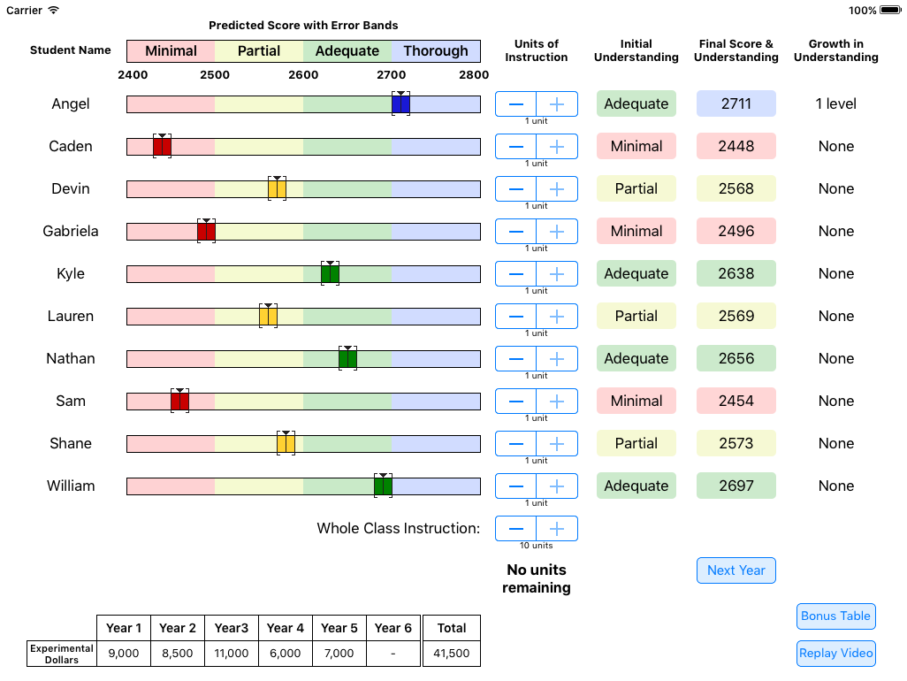

Slide 12
Empirical Model
Three-level hierarchical generalized linear model predicting the probability a student receives at least one unit of instruction
Reduce cluster bias in parameter estimates and correct standard errors for the non-independence of structural data
Students nested within classrooms nested within teachers

Slide 13
Empirical Model
η_{ijk} = γ₀₀₀ + γ₀₀₁(incentive_{k}) + γ₀₁₀(detailed_{jk}) + γ₁₀₀(threshold_{ijk}) + γ₁₀₁(threshold_{ijk}*incentive_{k}) + γ₂₀₀(partial_{ijk}) + γ₂₀₁(partial_{ijk}*incentive_{k}) + γ₂₁₀(partial_{ijk}*detailed_{jk})
+ γ₃₀₀(adequate_{ijk}) + γ₃₀₁(adequate_{ijk}*incentive_{k}) + γ₃₁₀(adequate_{ijk}*detailed_{jk}) + γ₄₀₀(threshold_{ijk}*partial_{ijk}) + γ₅₀₀(threshold_{ijk}*adequate_{ijk}) + r_{0jk} + u_{00k}

Slide 14
Empirical Model
η_{ijk} = γ₀₀₀ + γ₀₀₁(incentive_{k}) + γ₀₁₀(detailed_{jk}) + γ₁₀₀(threshold_{ijk}) + γ₁₀₁(threshold_{ijk}*incentive_{k}) + γ₂₀₀(partial_{ijk}) + γ₂₀₁(partial_{ijk}*incentive_{k}) + γ₂₁₀(partial_{ijk}*detailed_{jk})
+ γ₃₀₀(adequate_{ijk}) + γ₃₀₁(adequate_{ijk}*incentive_{k}) + γ₃₁₀(adequate_{ijk}*detailed_{jk}) + γ₄₀₀(threshold_{ijk}*partial_{ijk}) + γ₅₀₀(threshold_{ijk}*adequate_{ijk}) + r_{0jk} + u_{00k}

Slide 15
Empirical Model
η_{ijk} = γ₀₀₀ + γ₀₀₁(incentive_{k}) + γ₀₁₀(detailed_{jk}) + γ₁₀₀(threshold_{ijk}) + γ₁₀₁(threshold_{ijk}*incentive_{k}) + γ₂₀₀(partial_{ijk}) + γ₂₀₁(partial_{ijk}*incentive_{k}) + γ₂₁₀(partial_{ijk}*detailed_{jk})
+ γ₃₀₀(adequate_{ijk}) + γ₃₀₁(adequate_{ijk}*incentive_{k}) + γ₃₁₀(adequate_{ijk}*detailed_{jk}) + γ₄₀₀(threshold_{ijk}*partial_{ijk}) + γ₅₀₀(threshold_{ijk}*adequate_{ijk}) + r_{0jk} + u_{00k}

Slide 16
Empirical Model
η_{ijk} = γ₀₀₀ + γ₀₀₁(incentive_{k}) + γ₀₁₀(detailed_{jk}) + γ₁₀₀(threshold_{ijk}) + γ₁₀₁(threshold_{ijk}*incentive_{k}) + γ₂₀₀(partial_{ijk}) + γ₂₀₁(partial_{ijk}*incentive_{k}) + γ₂₁₀(partial_{ijk}*detailed_{jk})
+ γ₃₀₀(adequate_{ijk}) + γ₃₀₁(adequate_{ijk}*incentive_{k}) + γ₃₁₀(adequate_{ijk}*detailed_{jk}) + γ₄₀₀(threshold_{ijk}*partial_{ijk}) + γ₅₀₀(threshold_{ijk}*adequate_{ijk}) + r_{0jk} + u_{00k}

Slide 17
Note: * p < .05, ** p < .01, *** p < .001; MCRM = multilevel random coefficient model.

Slide 18
Note: * p < .05, ** p < .01, *** p < .001; MCRM = multilevel random coefficient model.

Slide 19
Note: * p < .05, ** p < .01, *** p < .001; MCRM = multilevel random coefficient model.
Given financial incentives, pre-service teachers are 47% less likely to allocate at least one unit of instruction to the average student.

Slide 20
Note: * p < .05, ** p < .01, *** p < .001; MCRM = multilevel random coefficient model.
Pre-service teachers are 11% less likely to allocate at least one unit of instruction to the average student given a one unit increase in threshold distance.

Slide 21
Note: * p < .05, ** p < .01, *** p < .001; MCRM = multilevel random coefficient model.
This relationship increases to a 69% reduction in probability for teachers earning financial incentives.

Slide 22
Note: * p < .05, ** p < .01, *** p < .001; MCRM = multilevel random coefficient model.
Pre-service teachers are 57% less likely to allocate at least one unit of instruction to the average student with a partial initial understanding.

Slide 23
Note: * p < .05, ** p < .01, *** p < .001; MCRM = multilevel random coefficient model.
Given financial incentives, pre-service teachers are 4.8 times more likely to allocate at least one unit of instruction to the average student with a partial initial understanding.

Slide 24
Note: * p < .05, ** p < .01, *** p < .001; MCRM = multilevel random coefficient model.
Pre-service teachers are 79% less likely to allocate at least one unit of instruction to the average student with a adequate initial understanding.

Slide 25
Note: * p < .05, ** p < .01, *** p < .001; MCRM = multilevel random coefficient model.
Given financial incentives, pre-service teachers are 62% more likely to allocate at least one unit of instruction to the average student with a adequate initial understanding.

Slide 26
Future Research
Limitation: sample
Limitation: financial incentive structure
Limitation: experimental design

Slide 27
Future Research
Limitation: sample
current sample is representative of program, but not state
Limitation: financial incentive structure
Limitation: experimental design

Slide 28
Future Research
Limitation: sample
Limitation: financial incentive structure
incentive structure affects teachers’ interpretation of success
Limitation: experimental design

Slide 29
Future Research
Limitation: sample
Limitation: financial incentive structure
Limitation: experimental design
number of students per class
fixed number of units of instruction
constant return to instruction
instruction occurred in a single time period

