Slide 1
Inflation Research at the Cleveland Fed ASSA panel on research and monetary policymaking
Damjan Pfajfar
Vice President of the Center for Inflation Research
January 3, 2026
The views expressed herein are solely our own and do not necessarily reflect the official views of the Federal Reserve Bank of Cleveland or the Federal Reserve System.

Slide 2
Research and Regional Feds
St. Louis Fed - monetarism in 1960s
Minneapolis Fed – rational expectations and VAR methods in 1970s, credibility in 1980s
Richmond Fed – transparency in mid 1980s
Cleveland Fed – inflation targeting in late 1980s
See Bordo and Prescott, 2025 “Federal Reserve Structure and the Production of Monetary Policy Ideas”

Slide 3
Research, Regional Feds, and Academia
New ideas come into Fed through interaction with academics
Fed researchers needed to help develop the ideas
They are exposed to problems and operational details that the academics don’t necessarily see
Commitment to producing long-term beneficial projects
Fed’s decentralized structure acts like a partial commitment device for allowing differences of opinion to be made public
It also creates competition among 12 Reserve Banks and the Board
The debate improves monetary policy in the long run

Slide 4
Minneapolis Fed and Rational Exp., VARs
Connection of Mpls Fed to U of MN starts in late 1960s
Kareken, Wallace, Muench, Sargent try to build an MPS-like econometric model for Mpls Fed in which to derive optimal policy rules
Lucas (1972) “Expectations and the Neutrality of Money”
Abandon their project and start working on rational expectations
Minneapolis dept. research model really starts mid-70s under Pres. Willis
Department becomes orientated around long-term research
Sargent, Wallace, Sims, Prescott attract the good young researchers (consult at Mpls Fed)
Little immediate effect on FOMC policy, but ideas survive

Slide 5
Background for the Inflation Center
Federal Reserve Bank of Cleveland (FRBC) has a long history of innovation in the analysis of inflation
Developed measures of underlying inflation
Median CPI, Trimmed-mean CPI, Median PCE inflation
Posts daily inflation nowcasting results and model-based inflation expectations measures on the Bank’s website
Established a dedicated research conference series on inflation
Center formally announced on December 4, 2018
Center is an integrated component within the FRBC Research Department
Center serves as a promoter of all the inflation work across the Research Department

Slide 6
Inflation-Related Research
Promote research on inflation through journal publications and additional contributions to the Bank’s working paper series and Economic Commentary articles
Organize conferences
Annual conference with the ECB: Inflation: Drivers and Dynamics Conference
Organize sessions at CEBRA and ISF conferences
Inflation Research digest
Quarterly newsletter with new inflation-related working papers
Surveys of Inflation Expectations
SoFIE: quarterly representative survey of US firms (new questions coming soon)
Daily Consumer Survey of Expectations
Indirect Consumer Inflation Expectations

Slide 7
Survey of Firms’ Inflation Expectations
Expected CPI Inflation over Next 12 Months
Mean Percent
8
7
6
SoFIE (2025:Q4): 3.3
University of Michigan (Nov 2025): 4.5
5
NY Fed SCE (Oct 2025): 3.2
4
3
2
1
0
2018
2019
2020
2021
2022
2023
2024
2025
Sources: Cleveland Fed, University of Michigan, NY Fed.
Last data points: Cleveland Fed, 2025:Q4; University of Michigan, Nov 2025; NY Fed SCE, Oct 2025.

Slide 8
External Communications
Conversations on Central Banking series
Targeted for a wide audience including economists in policy and industry
“Alternative measures of inflation: a complement to standard metrics?”
Visit Conferences page on Center’s website for new events
Link: https://www.clevelandfed.org/center-for-inflation-research/inflation-conferences
Subscribers to Center for Inflation Research
Quarterly email updates covering new research, data products, and conferences
Inflation Research Digest
Increased outreach effort at local, domestic, and international levels

Slide 9
Inflation and MP: More Research Needed
Current issues that may be helpful for monetary policymaking
The impact of tariffs on inflation:
Will it be a one-time increase in the price level or a persistent increase in inflation?
Does it matter that the economy is not starting from steady state—it is coming after multiple years of elevated inflation
Small change in tariffs vs change in tariff “agenda”
The effect of tariffs on inflation expectations is also uncertain, although data suggest that households—but not firms or only firms in particular sectors—have reacted to this change in policy
Firms’ inflation expectations
Cleveland Fed’s SoFIE is one project to better understand firms’ inflation expectations
Insights into the relationship between firms’ inflation expectations, their input costs, and their pricing decisions

Slide 10
Inflation and MP: More Research Needed
More longer-run challenges that relate to inflation and policymaking
How to conduct monetary policy when the dual mandate objectives are in conflict?
How to weight the two objectives?
Neutral rate subject to considerable uncertainty: Empirically, how can we continue to refine our estimates to provide a better understanding of the current level of the neutral rate?
Another opportunity is to study “optimal” communication practices
New approaches in the empirical macroeconomics, like Randomized Controlled Trials could be utilized to study this question
Interactions between Federal Reserve System and academia would be highly valuable to get new insights into these questions and others

Slide 11
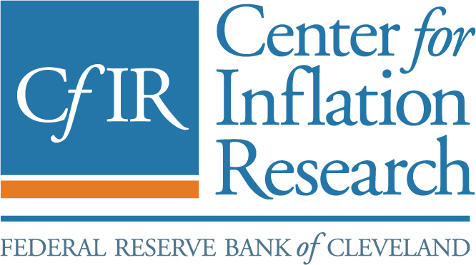
The Center for Inflation Research
The Center for Inflation Research is designed to serve as a leading resource for “all things inflation”
Measuring success in advancing the understanding of the inflation process
Contributions to Cleveland Fed monetary policy process and to debates and issues within the Federal Reserve System
Expanded research in academic journal articles and Cleveland Fed publications
ClevelandFed.org/cfir

